Slide 1
How to Program a SmartPhone: OpenMoko
Sneha Gopinath
WINLAB, Rutgers University
Acknowledgements: Pravin Shankar,
Department of Computer Science, Rutgers University
Ronak Daya, WINLAB

Slide 2
Outline
Introduction to the phone: Architecture & Features
Getting started and Developing on the OpenMoko
How can You use it in Your Research
Example Applications and Demo

Slide 3
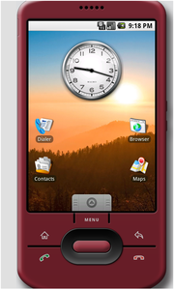
Open Source Smart phones
Android: Google developed Software platform for mobile devices, powered by the Linux kernel.
OFono: Nokia and Intel collaboration

Slide 4

What is OpenMoko?
Linux based SmartPhone platform
– Hardware (Neo Freerunner 1973)
– Software (Om 2008.8)
Wifi/GPS/GPRS/Bluetooth/... etc.
Open Source hardware and software

Slide 5
The Hardware – Neo FreeRunner
● 500 MHz Samsung (ARM) Processor
● 128 MB SDRAM, 256 MB NAND Flash
● Touchscreen
● Wifi – 802.11b/g Atheros based chipset
● GPS/AGPS
● GSM/GPRS
● Accelerometer – 2 tri-axis sensors

Slide 6
The Software OM2008.8
● OS Linux 2.6.24
● Languages C/Java/Python/...
● GUI X11/Qtopia
● uBoot
● Installer – opkg

Slide 7
SSHing into the Phone
● Over USB
– ifconfig usb0 192.168.0.200 netmask 255.255.255.0
– ssh root@192.168.0.202
● Over wireless
– Using the phone’s terminal, add Network to /etc/wpa_supplicant/wpa_supplicant.conf
– ifdown eth0 && ifup eth0
– ssh root@IP
where IP is the IP address of eth0

Slide 8
Installing sw using opkg
Example (installing a web server apache)
– cd /etc/opkg
– wget http://buildhost.automated.it/scaredycat.conf
– opkg update
– opkg install apache2

Slide 9
Developing Applications
Using C
  Cross compiler available at http://downloads.openmoko.org/toolchains
  GCC command for compiling: /usr/local/openmoko/arm/bin/arm-angstrom-linux-gnueabi-gcc –o foo foo.c
  Copy the executable to the phone:
scp foo root@openmoko:~/

Slide 10
Developing contd.
Using Python:
As simple as:
– opkg install python-core
● Graphical API:
– GTK
– ETK
Using Java:
Cacao:
– JVM implementation for OpenMoko
– http://www.cacaojvm.org

Slide 11
Interfaces and Drivers
Wifi: eth0 – Atheros AR6K driver
Same commands as on a regular Linux laptop (iwconfig/iwlist/dhclient/...)
Accelerometer: Two sensors:
– /dev/input/event2 and /dev/input/event3
GPS: – opkg install gpsd
– gpsd /dev/ttySAC1
– nc localhost 2947
– r

Slide 12
Applications in WINLAB
Similar to Orbit Nodes
Mobility
Localization
Social Networking Applications
Create your own Iphone like apps

Slide 13
Examples
  Accelerometer Positioning
  Live Twitter updates giving Location
  Live GPS location tracking

Slide 14
Additional Resources
● Openmoko Wiki:
– http://wiki.openmoko.org/wiki/Main_Page
– Google :-)
<search term> site:http://wiki.openmoko.org/wiki/
● Planet Openmoko http://planet.openmoko.org/
● Source Code (git repo) http://git.openmoko.org/
● Mailing list: http://lists.openmoko.org/mailman/listinfo/

Slide 15
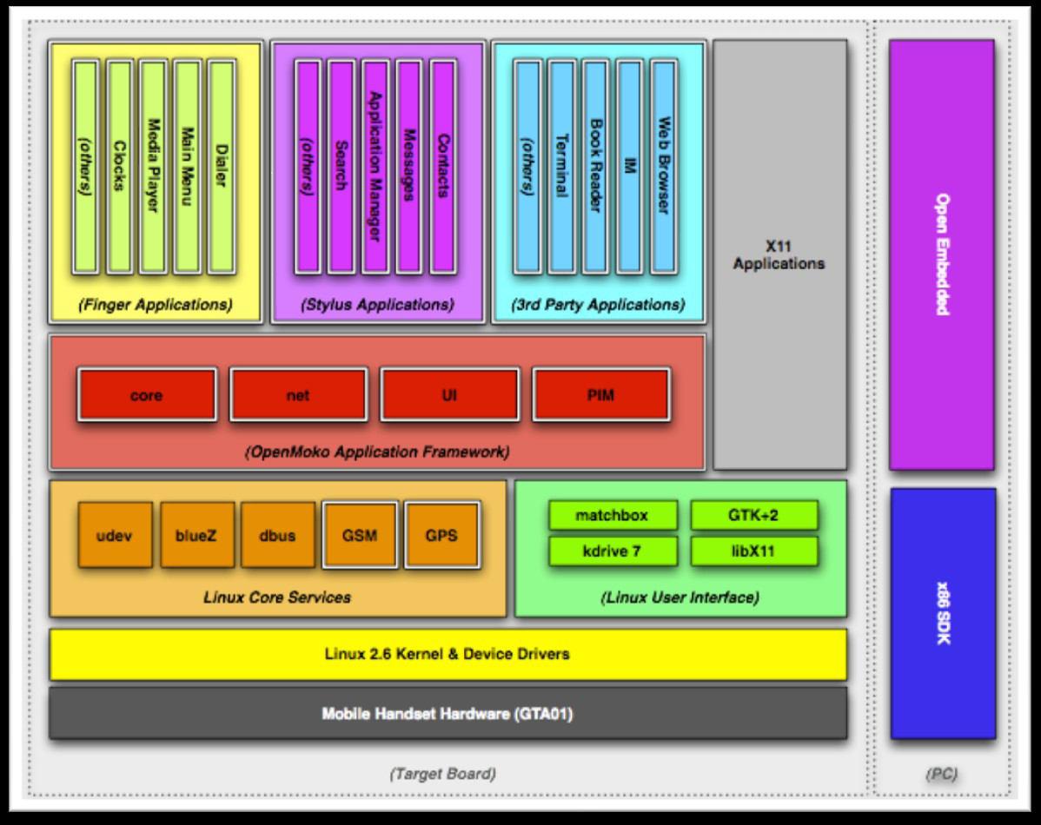
Internal Architecture

